Slide 1

MAHARAJA INSTITUTE OF TECHNOLOGY MYSORE BELAWADI, NAGUVANAHALLI POST, SRIRANGAPATNA TALUK, MANDYA-571477, KARNATAKA DEPARTMENT OF INFORMATION SCIENCE AND ENGINEERING
“Prediction of Brain Stroke using Machine Learning ”
Presented by
Amarnath R(4MH21IS006)
Ankith TP(4MH21IS011)
Jagath Ponnanna P M(4MH21IS116)
Sandesh K M(4MH22IS416)
Under the Guidance of
Prof. Bhavyashree H D
Asst. Professor
Dept of ISE

Slide 2
Agenda
Introduction
Objectives
Literature Survey
Drawbacks of Existing System
Problem Statement
Proposed System
Software Requirements Specification
System Design
Applications
Conclusion
References
Page 1

Slide 3
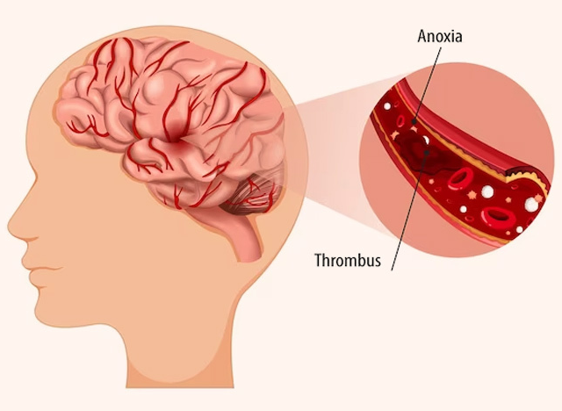
Introduction
Brain Stroke: A Silent Threat
A stroke occurs when blood supply to the brain is interrupted, leading to potential brain damage.
It is one of the leading causes of disability and death worldwide.
Early detection and prevention are crucial to reducing its impact.
Page 2

Slide 4
Objectives
To improve model accuracy using feature selection
To implement of multiple machine learning algorithms for better prediction
To improve reliability by reducing false positives and false negatives
A user-interface to input data and receive stroke risk assessment
Page 3

Slide 5
Literature Survey
Sl. No. | Title | Author | Year | Contributions & Drawbacks
1 | Brain Stroke Detection through Advanced Machine Learning and Enhanced Algorithms | P. Yogendra Prasad, Kothapalli Lalasa, M. Ramu, Dasari Hasrith, Komali Anitha, Boggula Aarthi Reddy. | 2024 | Train machine learning models, including XGBoost and LGBM Handling Missing data from collected data High computational requirements make real-time processing in clinical settings challenging. The complexity of advanced algorithms like XGBoost reduces interpretability,
Page 4

Slide 6
Literature Survey
Sl. No. | Title | Author | Year | Contributions & Drawbacks
2 | A Review on Predicting Brain Stroke using Machine Learning | Shehzada Mushtaq, Kamaljit Singh Saini | 2023 | Use of models like SVM, Random Forest and Artificial Neural Networks It relies on imbalanced datasets, which may lead to biased predictions and reduced model effectiveness
Page 5

Slide 7
Literature Survey
Sl. No. | Title | Author | Year | Contributions & Drawbacks
3 | A Novel Approach to Predict Brain Stroke using KNN in Machine Learning. | Dr. M Vasumathi Devi, S. Harshitha, K. Lakshmi Ramya, B. Hema Latha, P. Pranathi. | 2023 | Train KNN and compare it with other models like Decision Trees and Neural Networks. Evaluate model accuracy using metrics like precision, recall, F1-score, The model lacks interpretability, making it difficult for healthcare professionals to understand decision-making processes.
Page 6

Slide 8
Literature Survey
Sl. No. | Title | Author | Year | Contributions & Drawbacks
4 | Brain Stroke Prediction Using Machine Learning Techniques. | Ibrahim Almubark | 2023 | Apply SelectKBest (ANOVA test) for feature selection to retain the most relevant stroke predictors. The model is trained only on physical and numerical data, lacking integration with medical imaging or genomic data for better clinical predictions
Page 7

Slide 9
Literature Survey
Sl. No. | Title | Author | Year | Contributions & Drawbacks
5 | Optimizing Stroke Prediction with Ensemble Learning: A Comparative Study of AdaBoost, SVM, and KNN Models | Ankita Sharma, Sonam Mittal | 2024 | The research focuses on ensemble learning with a voting classifier The Voting Classifier achieves the highest accuracy outperforming individual ML models. Ensemble learning increases computational complexity, making real-time deployment challenging.
Page 8

Slide 10
Literature Survey
Sl. No. | Title | Author | Year | Contributions & Drawbacks
6 | Machine Learning-Based Early Detection for Brain Stroke. | Abdullah Khan, Hasnain Abbas Sherazi, Nimra Saleem, Waqas Tariq Toor. | 2024 | The study highlights feature importance analysis, showing that factors like age and smoking status significantly influence stroke prediction Certain ML models, like Logistic Regression, may not capture complex non-linear relationships in stroke risk factors
Page 9

Slide 11
Literature Survey
Sl. No. | Title | Author | Year | Contributions & Drawbacks
7 | Early Prediction of Stroke using Machine Learning | Dr. G. Revathy, Dr. U. Sesadri, Mrs. J. Justina Princy Thilagavathy, Mrs. S. Senthilvadivu, V. Senthil Murugan | 2023 | The dataset, is processed using Random Forest, XGBoost, Support Vector Machine (SVM), and Logistic Regression to predict stroke risk. Random Forest achieves the highest accuracy of outperforming other models Models, like Logistic Regression, struggle with complex non-linear relationships in stroke prediction.
Page 10

Slide 12
Literature Survey
Sl. No. | Title | Author | Year | Contributions & Drawbacks
8 | Predicting the Risks of Brain Stroke Using Machine Learning Models and Artificial Neural Network. | Nafiz Nahid, Mehrab Hossain, Ariful Islam Rifat, Meher Durdana Khan Raisa, Ashraful Islam. | 2023 | This study explores machine learning (ML) and artificial neural networks (ANN) for brain stroke risk prediction, and the custom ANN model reached the maximum accuracy with the SGD optimizer and batch size of 128 To address data imbalance, SMOTEENN (Synthetic Minority Oversampling Technique with Edited Nearest Neighbors) was used ANN models require high computational resources, making real-time deployment challenging
Page 11

Slide 13
Literature Survey
Sl. No. | Title | Author | Year | Contributions & Drawbacks
9 | Optimizing Stroke Diagnosis: Application of Machine Learning Algorithms for Early Detection. | Chetan Sharma, Anooja A, Jaydeep Kishore, Vivek Bhardwaj. | 2023 | Other ML models like XGBoost and Gradient Boost are explored along with SVM,Decision Tree It also has a focus on data collection , feature engineering and attribute selection Models, like SVM, struggle with complex non-linear relationships.
Page 12

Slide 14
Literature Survey
Sl. No. | Title | Author | Year | Contributions & Drawbacks
10 | Detection of Brain Stroke Using Machine Learning Algorithm. | Dr. E Sujatha, Monica D K. | 2023 | This paper explores models like Naïve Bayes, MLP and SVC Robust methods for handling missing values and normalization of data The study does not include imaging or genetic data, which could improve prediction accuracy.
Page 13

Slide 15
Literature Survey
Sl. No. | Title | Author | Year | Contributions & Drawbacks
11 | Unveiling the Innate Potential of Ensemble Techniques in Advanced Brain Stroke Classification | Preet Singh, Taniya Hasija, KR Ramkumar, | 2024 | This study explores machine learning (ML) ensemble techniques, utilizing models like CatBoost, and LightGBM (LGBoost) A Weighted Voting Ensemble Classifier is implemented to improve prediction accuracy by combining multiple models. The study does not include imaging or genetic data, which could improve prediction accuracy.
Page 14

Slide 16
Literature Survey
Sl. No. | Title | Author | Year | Contributions & Drawbacks
12 | Brain Stroke Prediction using Decision Tree Algorithm. | Viswanatha V, Ramachandra A C, Parameshachari B D, Aditya Kumar Sharma | 2023 | The Decision Tree classifier was trained with different tree depths (4, 9, and 16) to optimize accuracy The model with depth 4 achieved the highest accuracy of 90%+, demonstrating that a simpler tree structure improves performance Decision Trees are prone to overfitting, requiring careful parameter tuning.
Page 15

Slide 17
Literature Survey
Sl. No. | Title | Author | Year | Contributions & Drawbacks
13 | Predicting and Analyzing Early Onset of Stroke Using Advanced Machine Learning Classification Technique. | Puja Kumari, Bosco Paul Alapatt, Akhil M Nair, Jiby Jose, Jossy George, Riya Baby. | 2024 | A Bayes CV search-based hyper parameter tuning was used to optimize model performance. The research highlights the importance of feature selection, data balancing, and hyperparameter tuning in improving accuracy. The computational cost of hyperparameter tuning (Bayes CV search) is high, affecting real-time deployment.
Page 16

Slide 18
Literature Survey
Sl. No. | Title | Author | Year | Contributions & Drawbacks
14 | Enhancing Stroke Prediction with Machine Learning in Smart Healthcare Systems. | Shivam Nayak, Dr. Nishi Gupta. | 2024 | It focuses on the integration of stroke prediction with smart healthcare systems It implements only appropriate models like SVM, Random Forest, Neural Networks It does not focus on the actual implementation of brain stroke prediction, but only focuses on its integration with smart healthcare systems.
Page 17

Slide 19
Literature Survey
Sl. No. | Title | Author | Year | Contributions & Drawbacks
15 | Application of Machine Learning in Stroke Prediction: A Systematic Review. | Shah Khushbu, Amit Ganatra, Chintan Thacker. | 2024 | Feature selection algorithms have been properly implemented using correlation analysis and SMOTE algorithm The stacked ensemble model of CNN achieved high accuracy The dataset lacks diversity, affecting generalizability across populations, and also causes over-fitting
Page 18

Slide 20
Literature Survey
Sl. No. | Title | Author | Year | Contributions & Drawbacks
16 | A Novel Hybrid Approach Integrating Machine Learning and ANN for Stroke Risk Assessment. | Dr. Nagagopiraju Vullam, Maddala Janakidevi, S.V.V.D. Jagadeesh, Dr. A. Lakshmanarao, K. Siva Pavani, Y. S. N. Chandreswari. | 2024 | To enhance accuracy, ensemble learning and deep learning-based ANN models were implemented. The hybrid ML-ANN model outperformed all individual ML models, demonstrating improved accuracy and reliability Applying SMOTE and ADASYN techniques to balance the dataset. The study does not include genetic data, which may also be important feature
Page 19

Slide 21
Literature Survey
Sl. No. | Title | Author | Year | Contributions & Drawbacks
17 | Development of an Intelligent System for Brain Stroke Prediction using Ensemble Feature Selection and Machine Learning Technique. | Forhad Uddin Ahmed, Fahamida Hossain Mahi, Fahamida Hossain Mahi, Muhammad Nazrul Islam. | 2023 | Ensemble feature selection combines multiple feature selection methods to identify a robust and stable subset of relevant features, aiming to improve model performance and reduce the risk of choosing an unstable subset It uses logistic regression which may be ineffective with non-linear datasets.
Page 20

Slide 22
Literature Survey
Sl. No. | Title | Author | Year | Contributions & Drawbacks
18 | An Improved Concatenation of Deep Learning Models for Predicting and Interpreting Ischemic Stroke. | Sapiah Sakri, Shakila Basheer, Zuhaira Muhammad Zain, Nurul Halimatul Asmak Ismail, Dua’ Abdellatef Nassar, Ghadah Nasser Aldehim, Mais Ayman Alharaki. | 2024 | This study presents a hybrid deep learning model combining a convolutional neural network (CNN) and a long short-term memory (LSTM) network for ischemic stroke prediction. The CNN+LSTM model achieved 95% accuracy, outperforming all baseline models. It only talks about ischemic stroke and does not consider hemorhaghic stroke
Page 21

Slide 23
Literature Survey
Sl. No. | Title | Author | Year | Contributions & Drawbacks
19 | Blockchain-Enabled Digital Twin System for Brain Stroke Prediction | Venkatesh Upadrista, Sajid Nazir, Huaglory Tianfield. | 2025 | This paper presents the new concept integration of health and blockchain technology A digital twin is a virtual representation of a physical object/ being. The system is also scalable and adaptable, allowing predictions for other conditions like heart attacks, cancers, and epilepsy with minimal modifications. There are data privacy and security concerns
Page 22

Slide 24
Literature Survey
Sl. No. | Title | Author | Year | Contributions & Drawbacks
20 | Utilizing Gradient Boosting Models to Identify Risk Factors for Stroke. | Tamilselvi P, P. V. Narasimha Raju, C. Harini, Subbulakshmi R, Guduri Padma Rao, Ugranada Channabasava. | 2024 | The study found that age and hypertension are the most critical predictors, and the models provide personalized risk assessment for targeted interventions. One key limitation is the complexity of machine learning models, which often lack interpretability, making clinical adoption difficult. The study did not address real-world deployment challenges, such as integrating ML models into existing healthcare workflows
Page 23

Slide 25
Drawbacks of Existing System
Lack of Real-time Prediction: Many systems do not provide real-time risk assessment, delaying preventive actions.
Complexity in Implementation: Some advanced models require high computational power and expertise to deploy.
Interpretability Challenges: Many AI models, especially deep learning-based ones, function as "black boxes," making it difficult for doctors to trust their predictions.
Data Availability Issues: Stroke prediction requires large and diverse datasets, which are often limited or biased.
Page 24

Slide 26
Problem Statement
“ Stroke is the second leading cause of death worldwide. Stroke prediction is complex because it is dependence on numerous factors. A high stroke probability in data does not guarantee its occurrence due to genetic and biological factors ”
Page 25

Slide 27
Proposed System
Feature Selection: Selecting the most relevant features from the dataset to improve model efficiency and accuracy. Reducing dimensionality to eliminate redundant or less important features.
Model Evaluation Using K-Fold Cross-Validation: Splitting the dataset into multiple folds to ensure a robust evaluation of different models. Identifying the best-performing model based on average performance across all folds.
Machine Learning Model Implementation: Training and testing different machine learning models to predict stroke risk. Comparing model performance to select the most accurate one.
Page 26

Slide 28
Software Requirements Specification
Programming Language: Python
Libraries: TensorFlow, scikit-learn, Pandas, Numpy
Functional Requirements:
Implement machine learning models
Perform real-time stroke prediction based on input data
Allow data preprocessing, feature selection, and model evaluation.
Page 27

Slide 29
Software Requirements Specification
Non-functional Requirements:
Scalability: The system should efficiently handle increasing amounts of data without performance degradation.
Usability: The interface should be user-friendly and intuitive for all users.
Maintainability: The system should be easy to update, debug, and extend with minimal effort.
Performance: The system should provide quick response times and process data efficiently under varying loads.
Page 28

Slide 30
System Design : Architecture
Data Preprocessing
Features include hypertension, Glucose level, Heart Disease
Model Creation
Different ML methods like ANN, Naïve Bayes, XGBoost
Model Validation/Selection
Using k-cross validation and performance metrics
Predict Brain Stroke occurrence
Brain Stroke Prediction
Page 29

Slide 31
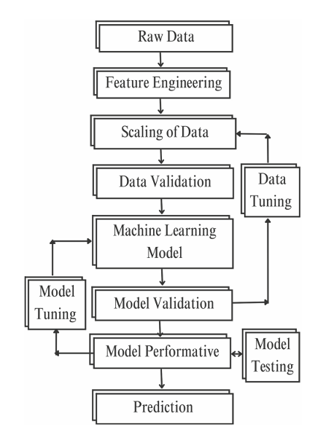
System Design
Page 30

Slide 32
Applications
Healthcare Providers
Personal Health Monitoring
Hospitals & Clinics
Public Health Campaigns
Health and Wellness Apps
Page 31

Slide 33
Thank You

